Slide 1
Outcomes vs. Objectives

Slide 2
Objective
Objective – A course objective describes what a faculty member will cover in a course.
They are generally less broad than goals and broader than student learning outcomes.

Slide 3
Examples of objectives include:
Upon completion of the course:
• Students will gain an understanding of the historical origins of art history.
• Student will read and analyze seminal works in 20th Century American literature.
• Students will study the major U.S. regulatory agencies.

Slide 4
Student Learning Outcome
A detailed description of what a student must be able to do at the conclusion of a course.
Often includes multiple objectives.

Slide 5
Student Learning Outcome
Analogy: Objectives are like the ingredients and the recipe; outcomes are the final product- the cake.

Slide 6
Strong outcomes:
Will include a description of the conditions and the acceptable performance level.
  Example: “when given x, students will _____”
Will include Bloom’s Taxonomy
Are specific and measurable
  measurability can be as simple as a single question on an exam.

Slide 7
outcomes statements
do not need to be complex.
One common form is a sentence of two clauses, where the first clause describes the situation, and the second an expectation.
In other words, the first part of the outcomes statement should describe the assessment tool or situation, and the second part the specific details of the outcome using verbs from Bloom’s Taxonomy, or its 2001 update, A Taxonomy for Teaching, Learning, and Assessment.

Slide 8
Examples of student learning outcomes: (Cont.)
Kinesiology
Given an anonymous sample health history, students will devise a personalized exercise plan focused on reducing stress.

Slide 9
Examples of student learning outcomes:
Art
Given an image of an unnamed twentieth century painting, students will correctly identify the artist’s style and explain the style’s social-historical context
Science
Provided with a dataset from the previous semester, students will successfully design a grounded research study based on the scientific method.

Slide 10
Examples of student learning outcomes: (Cont.)
English
In a final research paper, students will appropriately utilize grammar and various literary devices.

Slide 11
Student learning outcome
When writing outcomes, it is helpful to use verbs that are measurable or that describe an observable action.
Such verbs help faculty (and students) avoid misinterpretation.

Slide 12
Words Open to Many Interpretations
To know
To understand
To really understand
To appreciate
To fully appreciate
To grasp the significance of
To enjoy
To believe

Slide 13
Words Open to Fewer Interpretations
To write
To recite
To identify
To sort
To solve
To construct
To build
To compare
To contract

Slide 14

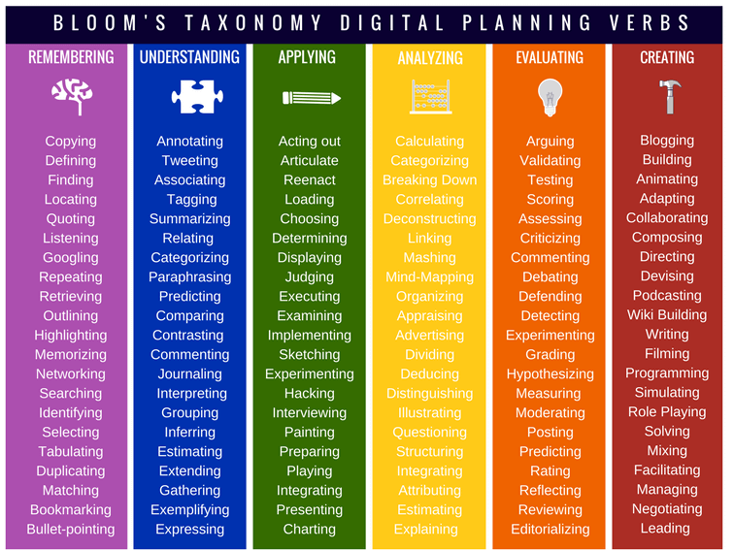
Okay Better

Slide 15
Rio recourse for creating outcomes:
Faculty Resource Center (FRC) in Canvas
Template
Outcomes Committee

Slide 16
Examples of student learning outcomes:
Examples are taken from Designing and Assessing Courses and Curricula, Third Edition, 2008. Robert M. Diamond. Jossey-Bass: San Francisco, CA.
https://ueap.sfsu.edu/sites/default/files/assets/docs/student_learning_outcomes.pdf
https://resources.depaul.edu/teaching-commons/teaching-guides/course-design/Pages/course-objectives-learning-outcomes.aspx
https://www.uclahealth.org/nursing/workfiles/Education%20Courses/ContinuingEducation/ce-LearningOutcome-v-LearningObjective-052016.pdf

